Slide 1
Transform data with Azure Data Factory or Azure Synapse Pipelines
Sashank Pappu
Azure Data & AI Specialist

Slide 2

Sashank Pappu
Azure Data & AI Specialist.
Certified from MIT on ‘Advanced Analytics and Big Data Challenges’. Technology Enthusiast and Data Specialist. Certified Designer in Computer Vision
• Microsoft Certified Azure Data Architect. • Microsoft Certified Azure Machine Learning Developer • Certified on Practical Data Analytics with Microsoft Cortana Intelligence Suite.
9+ years of total experience as Data Specialist and Data Engineer.
Certifications
Experience
Currently working as Independent Consultant on Azure Data & AI and Enterprise Trainer on Azure Data Analytics , Cortana Intelligence Suite and Cognitive Sciences
Expert facilitator and corporate behavioral trainer with 5 years of experience in designing programs, content development , Data Analytics and Machine Learning.
Role
Training
Sri Nag Sashank
Co-Founder & CTO of antz.ai , a niche Data & IoT company.

Slide 3




The session will span for 5 days & it is mandatory to attend all the days.
Self-Paced labs have been developed & access will be shared during the session.
The audience can participate in the leaning. However, it DOES NOT come with “Azure Subscriptions” & request users to arrange on their own.
A proctor will be available to take your queries via “Chat” window. Kindly “MUTE” and do not disturb the presenter.
The sessions are recorded. Will be made available through LMS at the end of series.
Note: More trainings on the same & similar topics would be delivered in near future. Keep your options open.
Guidelines for the event

Slide 4


Description
This module teaches how to build data integration pipelines to ingest from multiple data sources, transform data using mapping data flows and notebooks, and perform data movement into one or more data sinks.

Slide 5
Agenda
Introduction to Azure Synapse Analytics [15 minutes]
Execute code-free transformations at scale with Azure Synapse Pipelines
Introduction to Artifacts [10 minutes]
Demo [30 minutes]
Introduction to pipelines and dataflows [10 minutes]
Demo [30 minutes]
Introduction to Mapping Data Flows [10 minutes]
Demo [45 minutes]
Orchestrate data movement and transformation in Azure Synapse Pipelines
Introduction to triggers, monitoring and Orchestration [10 minutes]
Demo [30 minutes]
Overview [15 minutes]

Slide 6
Introduction to Azure Synapse Analytics

Slide 7

Azure Synapse Analytics
Limitless analytics service with unmatched time to insight
Artificial Intelligence / Machine Learning / Internet of Things
Intelligent Apps / Business Intelligence
Designed for analytics workloads at any scale
Synapse Analytics
SaaS developer experiences for code free and code first
Experience
Synapse Analytics Studio
Platform
Multiple languages suited to different analytics workloads
MANAGEMENT
Languages
MANAGEMENT
SQL
Python
.NET
Java
Scala
Integrated analytics runtimes available dedicated and serverless
Synapse SQL offering T-SQL for batch, streaming and interactive processing
Apache Spark for big data processing with Python, Scala and .NET
SECURITY
Form Factors
SECURITY
DEDICATED
SERVERLESS
MONITORING
Analytics Runtimes
MONITORING
SQL
METASTORE
METASTORE
DATA INTEGRATION
Integrated platform services for, management, security, monitoring, and meta-store
Azure
Data Lake Storage
Common Data Model
Enterprise Security
Optimized for Analytics
Data lake integrated and Common Data Model aware
Notes:
Hand it over to Lino

Slide 8
Lab 1:
Code-free transformation at scale with Azure Synapse Pipelines

Slide 9
Introduction on creating Artifacts

Slide 10
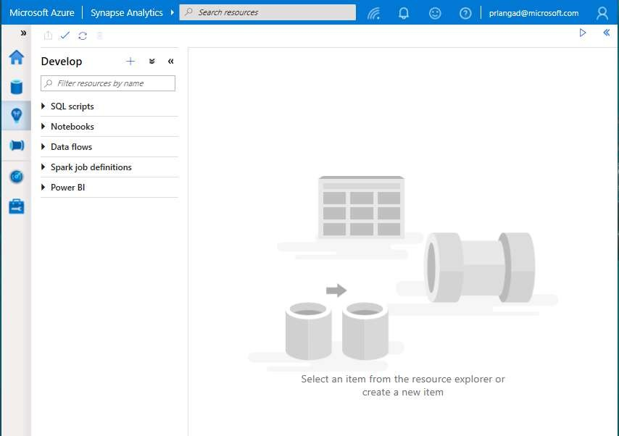
Develop Hub
Overview
It provides development experience to
query, analyze, model data
Benefits
Multiple languages to analyze data under one umbrella
Switch over notebooks and scripts without loosing content
Code intellisense offers reliable code
development
Create insightful visualizations

Slide 11
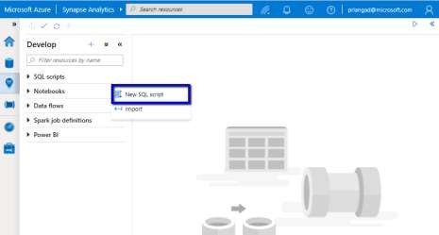
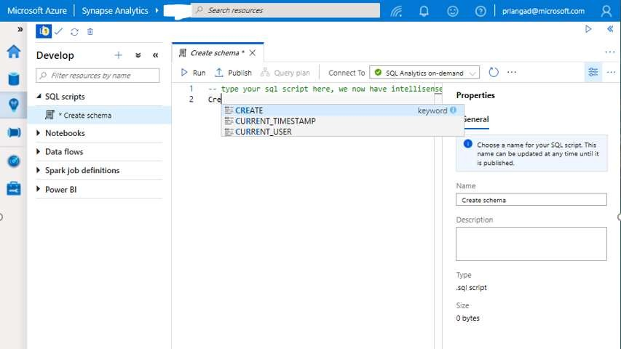
Develop Hub - SQL scripts
SQL Script
Authoring SQL Scripts
Execute SQL script on provisioned SQL Pool or SQL On-demand
Publish individual SQL script or multiple SQL scripts through Publish all feature
Language support and intellisense

Slide 12
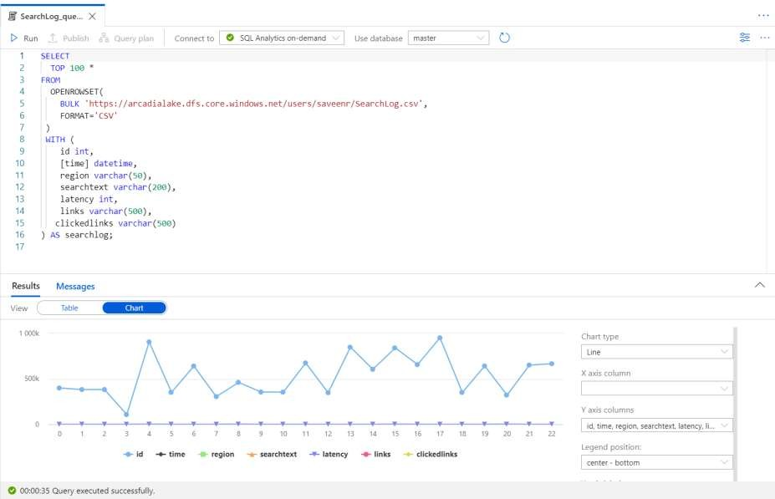
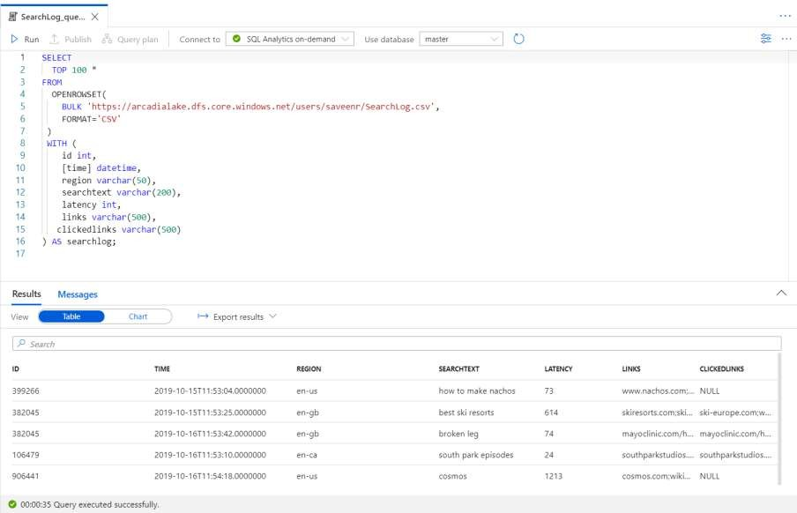
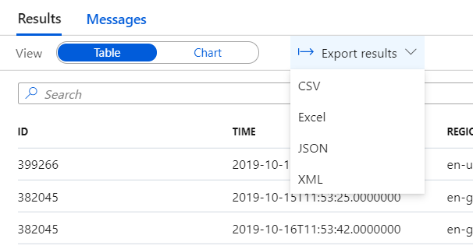
Develop Hub - SQL scripts
SQL Script
View results in Table or Chart form and export results in several popular formats

Slide 13
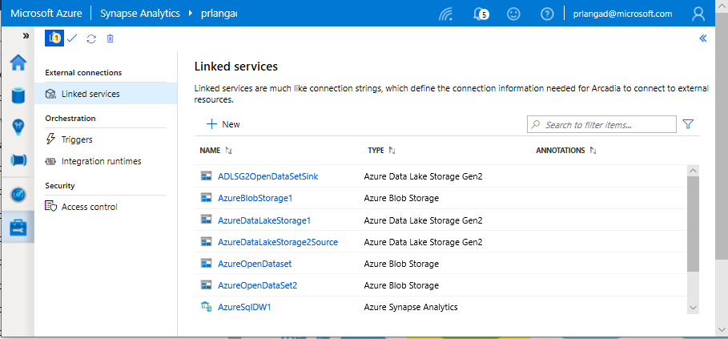
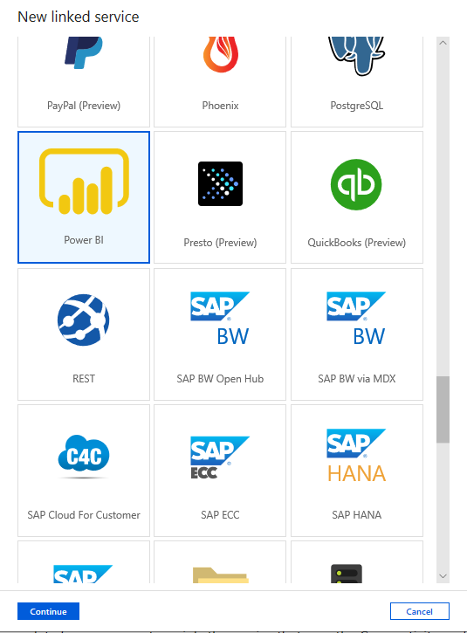
Linked services
Overview
Linked services define the connection information needed to connect to external resources.
Benefits
Offers pre-build 90+ connectors
Easy cross platform data migration
Represents data store or compute resources

Slide 14
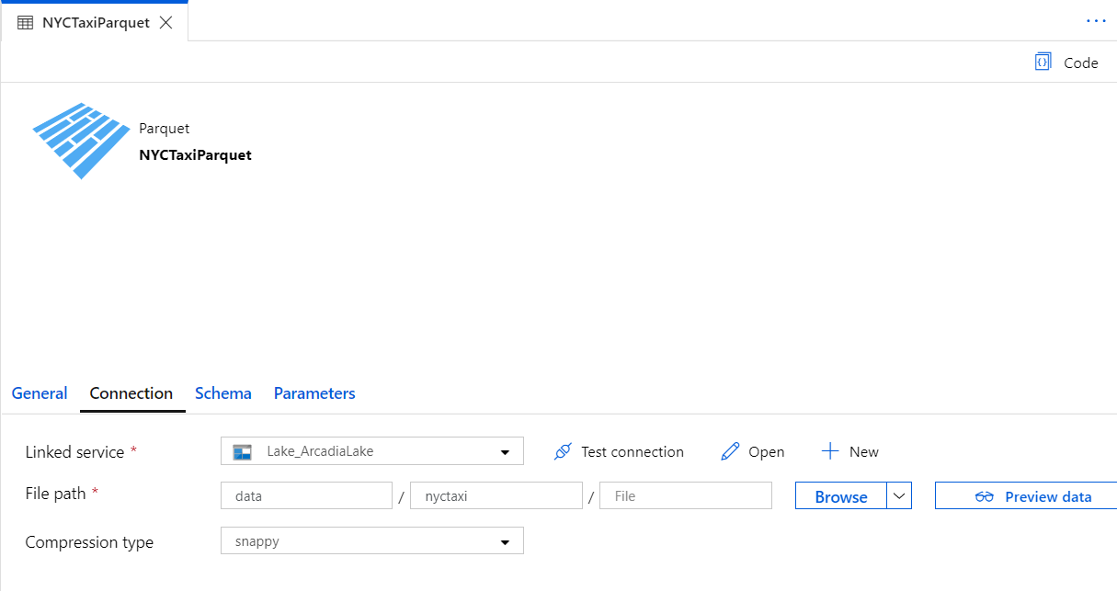
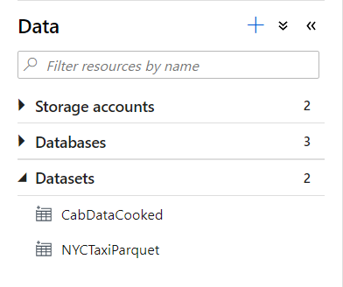
Datasets
Orchestration datasets describe data that is persisted.
Once a dataset is defined, it can be used in pipelines and sources of data or as sinks of data.

Slide 15
90+ Connectors out of the box
Azure (15) | Database & DW (26) |  | File Storage (6) | File Formats(6) | NoSQL (3) | Services and App (28) |  | Generic (4)
Blob storage | Amazon Redshift | Oracle | Amazon S3 | AVRO | Cassandra | Amazon MWS | Oracle Service Cloud | Generic HTTP
Cosmos DB - SQL API | DB2 | Phoenix | File system | Binary | Couchbase | CDS for Apps | PayPal | Generic OData
Cosmos DB - MongoDB API | Drill | PostgreSQL | FTP | Delimited Text | MongoDB | Concur | QuickBooks | Generic ODBC
Data Explorer | Google BigQuery | Presto | Google Cloud Storage | JSON |  | Dynamics 365 | Salesforce | Generic REST
Data Lake Storage Gen1 | Greenplum | SAP BW Open Hub | HDFS | ORC |  | Dynamics AX | SF Service Cloud
Data Lake Storage Gen2 | HBase | SAP BW via MDX | SFTP | Parquet |  | Dynamics CRM | SF Marketing Cloud
Database for MariaDB | Hive | SAP HANA |  |  |  | Google AdWords | SAP C4C
Database for MySQL | Apache Impala | SAP table |  |  |  | HubSpot | SAP ECC
Database for PostgreSQL | Informix | Spark |  |  |  | Jira | ServiceNow
File Storage | MariaDB | SQL Server |  |  |  | Magento | Shopify
SQL Database | Microsoft Access | Sybase |  |  |  | Marketo | Square
SQL Database MI | MySQL | Teradata |  |  |  | Office 365 | Web table
SQL Data Warehouse | Netezza | Vertica |  |  |  | Oracle Eloqua | Xero
Search index |  |  |  |  |  | Oracle Responsys | Zoho
Table storage
Notes:
formatting

Slide 16
Exercise – 1 : Create Artifacts [30 minutes] Task 1: Create SQL table Task 2: Create linked service Task 3: Create data sets Task 4: Create campaign analytics dataset

Slide 17
Break
(5 minutes)

Slide 18
Introduction to Pipelines and Data flows

Slide 19
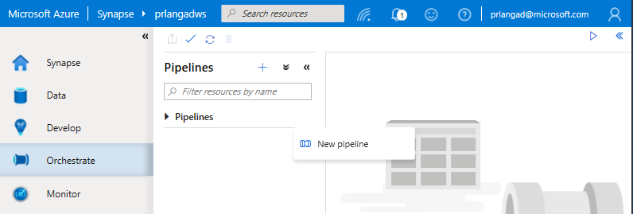
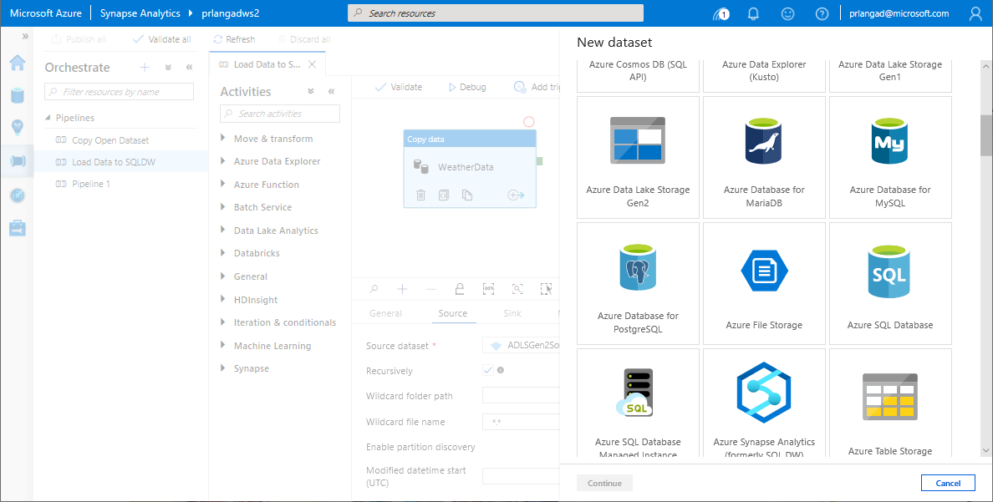
Pipelines
Overview
Provide ability to load data from storage account to desired linked service.
Load data by manual execution of pipeline or by orchestration.
Benefits
Supports common loading patterns.
Fully parallel loading into data lake or SQL tables.
Graphical development experience.

Slide 20
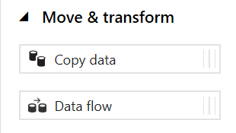
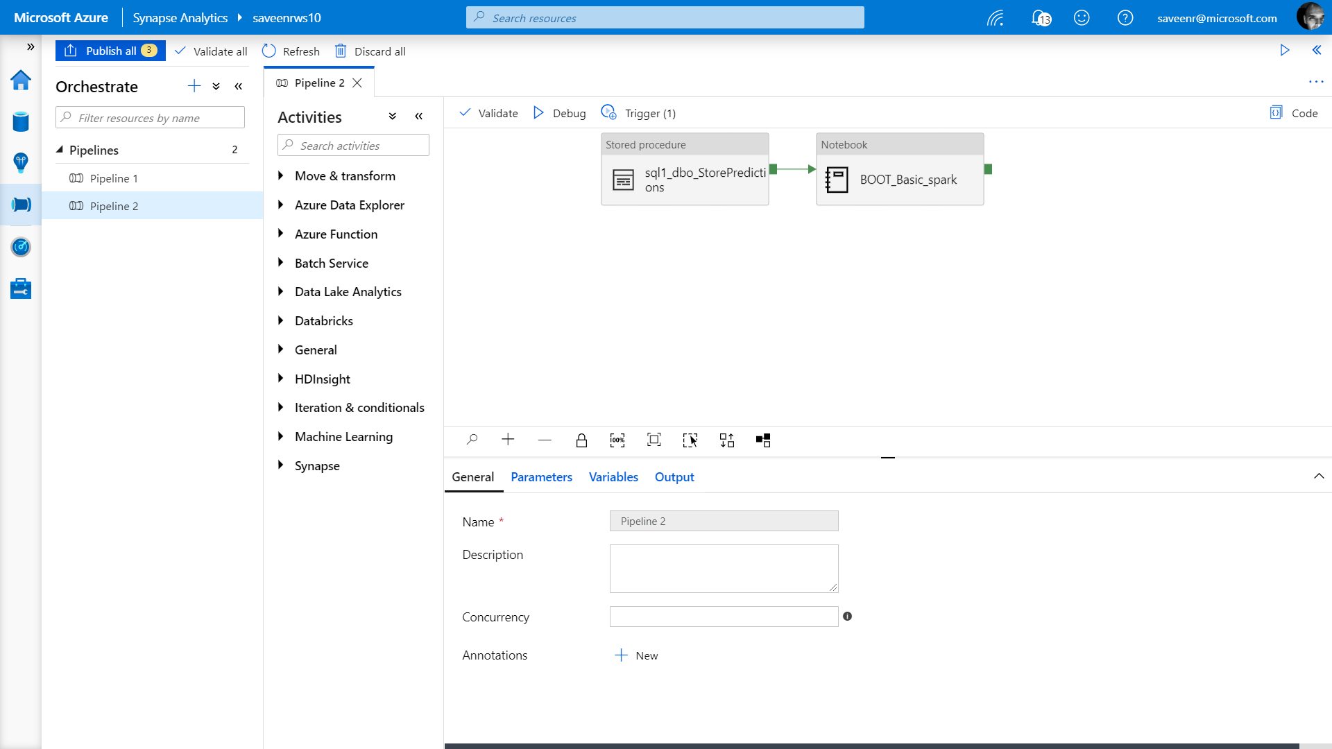
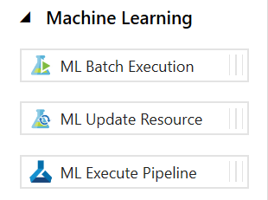
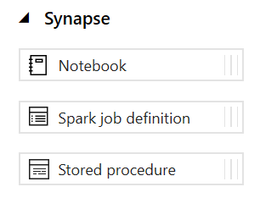
Pipelines
Create pipelines to ingest, transform and load data with 90+ inbuilt connectors.
Offers a wide range of activities that a pipeline can perform.

Slide 21
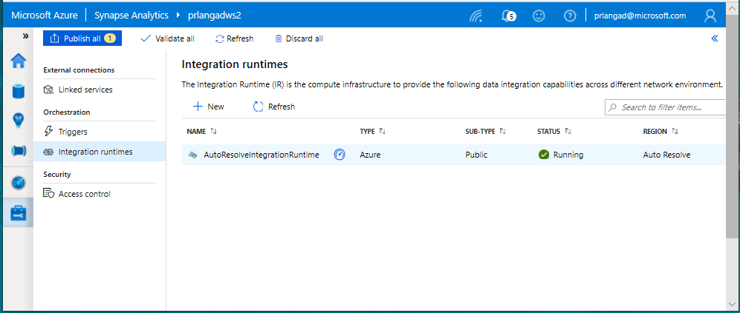
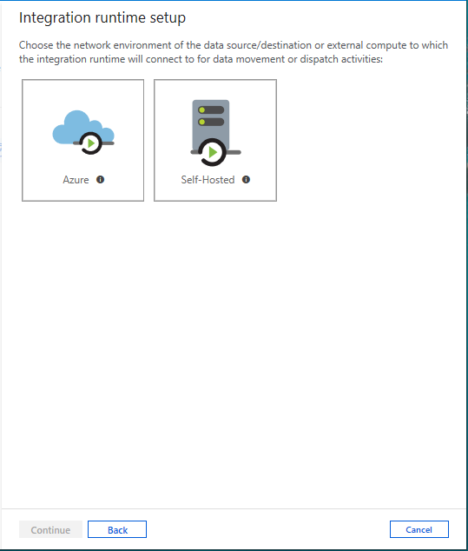
Integration runtimes
Overview
Integration runtimes are the compute infrastructure used by Pipelines to provide the data integration capabilities across different network environments. An integration runtime provides the bridge between the activity and linked services.
Benefits
Offers Azure Integration Runtime or Self-Hosted Integration Runtime
Azure Integration Runtime – provides fully managed, serverless compute in Azure
Self-Hosted Integration Runtime – use compute resources in on-premises machine or a VM inside private network
Notes:
Need to explain and why needed
Check with Gaurav

Slide 22
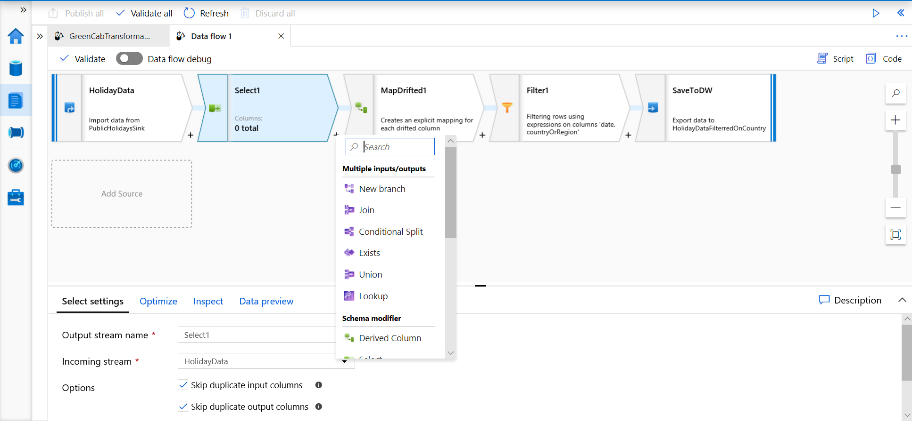
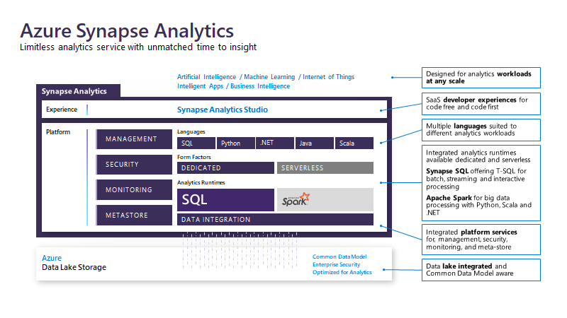
Data Flows
Data flows are a visual way of specifying how to transform data.
Provides a code-free experience.

Slide 23
Data Flow Capabilities
Handle upserts, updates, deletes on sql sinks
Add new partition methods
Add schema drift support
Add file handling (move files after read, write files to file names described in rows etc)
New inventory of functions (for e.g Hash functions for row comparison)
Commonly used ETL patterns(Sequence generator/Lookup transformation/SCD…)
Data lineage – Capturing sink column lineage & impact analysis(invaluable if this is for enterprise deployment)
Implement commonly used ETL patterns as templates(SCD Type1, Type2, Data Vault)

Slide 24
Exercise – 2 : Create data pipeline to import poorly formatted CSV [30 minutes] Task 1: Create campaign analytics data flow Task 2: Create campaign analytics data pipeline Task 3: Run the campaign analytics data pipeline Task 4: View campaign analytics table contents

Slide 25
Break
(5 minutes)

Slide 26
Introduction to Mapping data flows

Slide 27
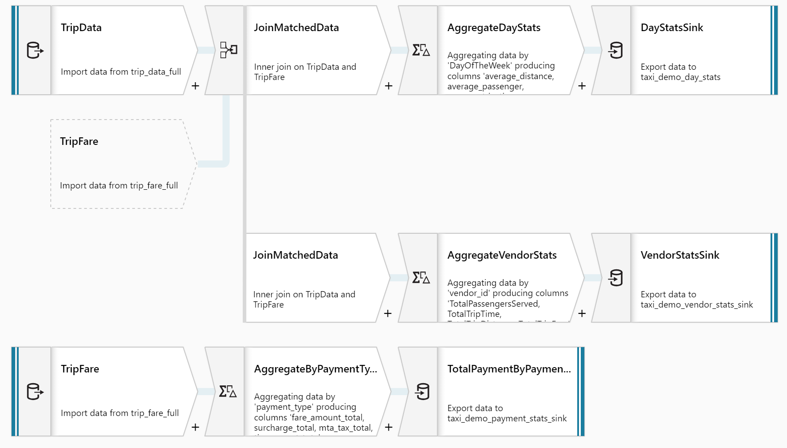
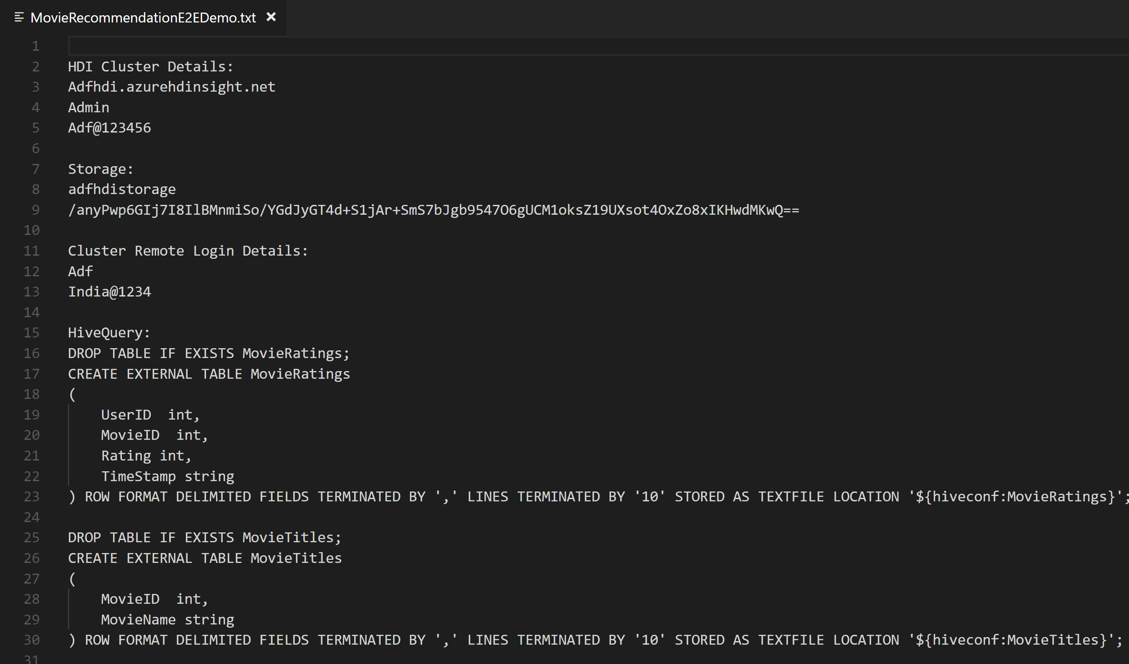
No Code Transform with Mapping Data Flows
Overview
It offers data cleansing, transformation, aggregation, conversion, etc.
Benefits
Cloud scale via Spark execution
Guided experience to easily build resilient data flows
Flexibility to transform data per user’s comfort
Monitor and manage dataflows from a single pane of glass
This…
NOT this…

Slide 28

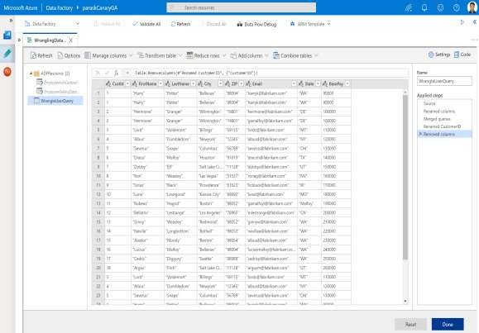
Prep & Transform Data
Mapping Dataflow
Code free data transformation @scale
Wrangling Dataflow
Code free data preparation @scale

Slide 29
Exercise – 3 : Create Mapping Data Flow for top product purchases [45 minutes] Task 1: Create campaign analytics data flow Task 2: Create campaign analytics data pipeline Task 3: Run the campaign analytics data pipeline Task 4: View campaign analytics table contents

Slide 30
Break
(15 minutes)

Slide 31
Lab 2: Orchestrate data movement and transformation in Azure Synapse Pipelines

Slide 32
Introduction to Triggers, Monitoring and Orchestration

Slide 33
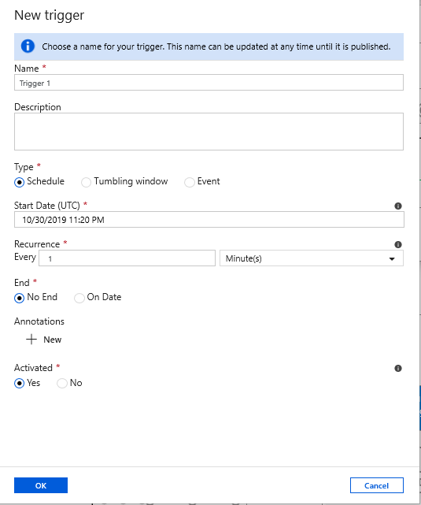
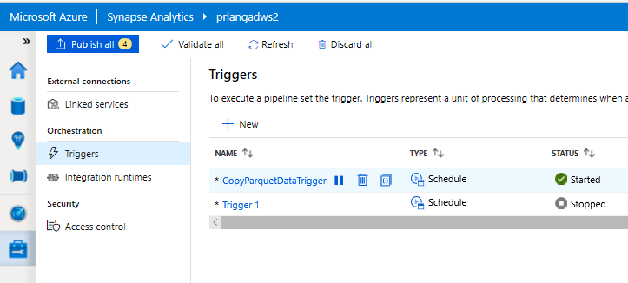
Triggers
Overview
Triggers represent a unit of processing that determines when a pipeline execution needs to be kicked off.
Data Integration offers 3 trigger types as –
Schedule – gets fired at a schedule with information of start date, recurrence, end date
Event – gets fired on specified Storage event
Tumbling window – gets fired at a periodic time interval from a specified start date, while retaining state
It also provides ability to monitor pipeline runs and control trigger execution.

Slide 34
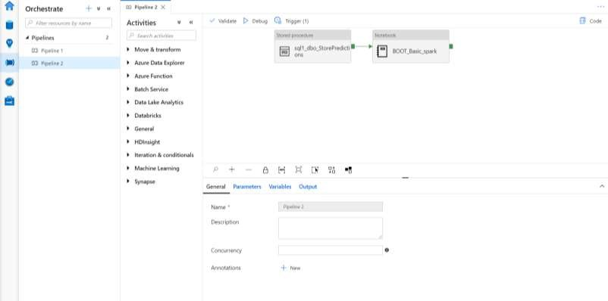
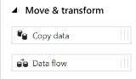
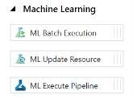
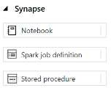
Orchestrate Hub
It provides ability to create pipelines to ingest, transform and load data with 90+ inbuilt connectors.
Offers a wide range of activities that a pipeline can perform.

Slide 35
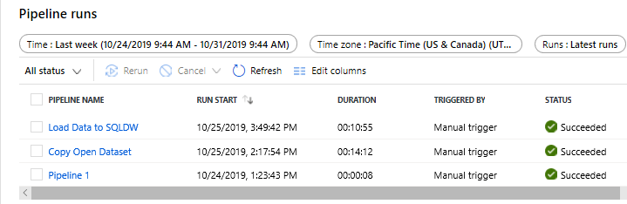
Orchestration
Overview
Monitor orchestration in the Synapse workspace for the
progress and status of pipeline
Benefits
Track all/specific pipelines
Monitor pipeline run and activity run details
Find the root cause of pipeline failure or activity failure

Slide 36


Components of Orchestration
Trigger
Pipeline
foreach (…)
On demand
Schedule
Data Window
Event
Activity
Activity
Activity
Activity
Activity
Self-hosted
Integration Runtime
Azure
Integration Runtime
Linked
Service
LEGEND
On-prem
Apps & Data
Azure Services
Command and Control
Data
Synapse Pipelines shares codebase with Azure Data Factory

Slide 37
Exercise – 1 : Create, trigger, and monitor pipeline [30minutes] Task 1: Create pipeline Task 2: Trigger, monitor, and analyze the user profile data pipeline

Slide 38
Questions to ask customer
Can you use the cloud?
Is this a new solution or a migration?
What is the skillset of the developers?
Will you use non-relational data (variety)?
How much data do you need to store (volume)?
Is this an OLTP or OLAP/DW solution?
Will you have streaming data (velocity)?
Will you use dashboards and/or ad-hoc queries?
Will you use batch and/or interactive queries?
How fast do the operational reports need to run?
Will you do predictive analytics?
Do you want to use Microsoft tools or open source?
What are your high availability and/or disaster recovery requirements?
Do you need to master the data (MDM)?
Are there any security limitations with storing data in the cloud?
Does this solution require 24/7 client access?
How many concurrent users will be accessing the solution at peak-time and on average?
What is the skill level of the end users?
What is your budget and timeline?
Is the source data cloud-born and/or on-prem born?
How much daily data needs to be imported into the solution?
What are your current pain points or obstacles (performance, scale, storage, concurrency, query times, etc)?
Are you ok with using products that are in preview?

Slide 39
Top 10 questions
Can I access storage accounts, other than the one I setup the Synapse workspace with?
Yes you can. To add a new storage account, just create a new linked service to the storage and it will show up in the data hub, under storage
Will anyone who has access to the workspace have access to the storage account?
No, folks who do not have access to the storage account will see it but won’t have access
Is Power BI in Synapse a replacement of Power BI Desktop ?
You can connect your Power BI service workspace to the Synapse workspace. It is not the authoring tool like Power BI desktop but more like
Power BI service
Can I run OPENROWSET statement using SQL Pool?
No, you can only run OPENROWSET statement from SQL on-demand
We can create a Spark pool and SQL pool from the portal, but how do we create a SQL on-demand database? You can create a SQL on-demand database by running a create database on a SQL script in the studio
Can I import my existing Azure SQL DW into Synapse?
Not yet. When you create a SQL Pool, you have the option to create a blank DB, restore from a back up or Restore point. You can restore the DB but it is a new database
Does Synapse Analytics support delta lake? Yes, we support delta lake. It is already available.
VNet Integration and restricted access to client IP’s? Soon
Is Data Discovery & Classification available? Soon
Auditing to log analytics? Soon

Slide 40
Overview

Slide 41
Q & A

